Slide 1


Monitoring ESXi 7.0 With
Enterprise-grade monitoring on a $0 - 3.00 budget

Slide 2

About Me:
Bill Kindle – Systems Administrator
Contributor to The PowerShell Conference Book vol. 2 / A Editor for vol. 3
Writes for AdamTheAutomator.com and Content Contributor at TechSnips.io
Is really into model railroading and trains
Father of two wonderful, sticky, little people who don’t pay rent.
Husband to a loving wife whom he’d be absolutely lost without.

Slide 3
Some of What Will Be Covered:
What Zabbix is
System requirements
Installing Zabbix Server
Configuring Zabbix Server
Setup ESXi host monitoring
Short discussion on Items & Triggers
Where to get help and available training options

Slide 4
Goal
That you walk away with enough knowledge to meet your ESXi monitoring needs for free.

Slide 5
Systems & Tools Being Used
Zabbix 5.0 LTS
Ubuntu Server 20.04 LTS
VMware ESXi 7.0
PowerShell 7 / Windows Terminal (For SSH Remoting)
Text Editor (in this case, nano)
Notes and other material are available on my Github repository
QR code link at end of presentation.

Slide 6
What is Zabbix
Free, Open Source, scalable and customizable enterprise-grade monitoring and alerting system.

Slide 7
Minimum System Requirements to Run Zabbix
Physical Memory - 128 MB
Disk Space - 256 MB free

Slide 8
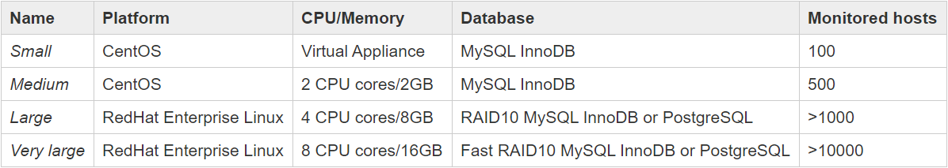
Zabbix System Sizing Chart
Source: https://www.zabbix.com/documentation/current/manual/installation/requirements

Slide 9
Installing Zabbix 5.0 LTS
6-Minute Walkthrough

Slide 10
DEMO

Slide 11
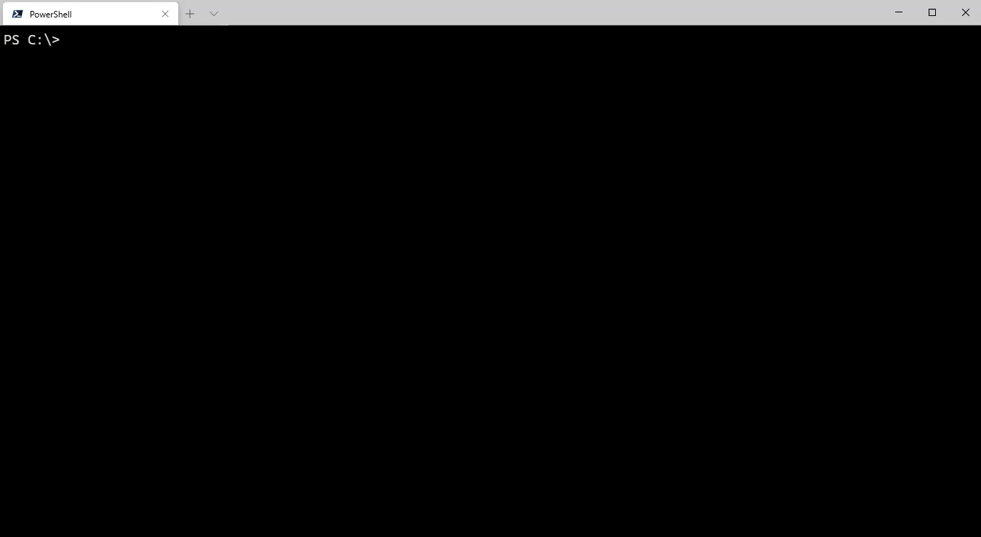

Slide 12
Monitoring ESXi with Zabbix

Slide 13
Item
- a particular piece of data that you want to receive off of a host, a metric of data.

Slide 14
Trigger
- a logical expression that defines a problem threshold and is used to “evaluate” data received in items.
When received data are above the threshold, triggers go from 'Ok' into a 'Problem' state. When received data are below the threshold, triggers stay in/return to an 'Ok' state.

Slide 15
DEMO

Slide 16
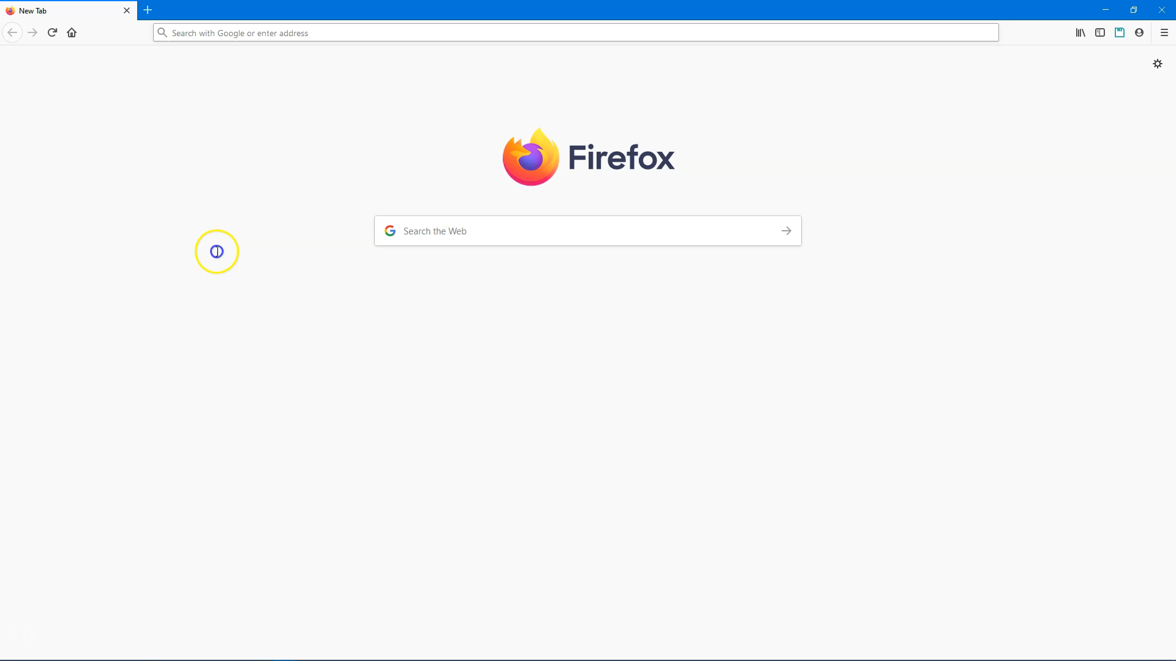

Slide 17
More Ways to Learn
Support Options and Documentation

Slide 18
Getting Help
https://www.zabbix.com/forum/ | Zabbix User Forums
https://www.zabbix.com/manuals | Zabbix Documentation
Both are excellent resources!

Slide 19
Getting Help (Paid Support Plans)
If you want paid technical support direct from Zabbix,
multi-tier plans are available for purchase:
https://www.zabbix.com/support

Slide 20
Questions?

Slide 21


Thanks for Attending!
Presentation Materials
Connect with me
LinkedIn
Github

